Slide 1


CUSTOMER CHURN PREDICTION FOR SYRIATEL
A Machine Learning Approach to Retain Customer
Presented by: George Mochama Edwin

Slide 2
Project Overview
Key Points:
Develop a binary classification model to predict customer churn.
Analyze behavior, usage patterns, and demographics.
Goal: Enable targeted retention strategies to minimize revenue loss.

Slide 3
Problem Definition
Objective: Predict customer churn (Yes/No) using ML models.
Outcome: Provide actionable insights to:
Reduce churn rates.
Enhance customer retention and satisfaction.
Metrics for Success:
Accuracy, Precision, Recall, F1-Score, AUC-ROC.

Slide 4
Data Collection
Dataset Source: Kaggle.
Dataset Link: Kaggle Dataset.
Data Format: CSV.
Features: Demographics, account details, usage patterns.

Slide 5
Data Preparation
Cleaning:
Removed irrelevant columns (phone number, state, area code).
Verified no missing or duplicate data.
Encoding:
Transformed international plan and voice mail plan into binary (Yes → 1, No → 0).
Scaling:
Normalized numerical features using Min-Max Scaling.
Outlier Handling:
Detected outliers using boxplots.
Removed outliers using the IQR method.

Slide 6
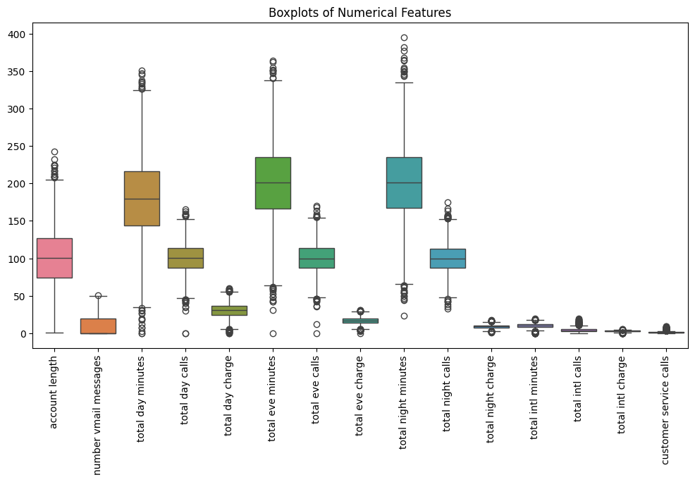
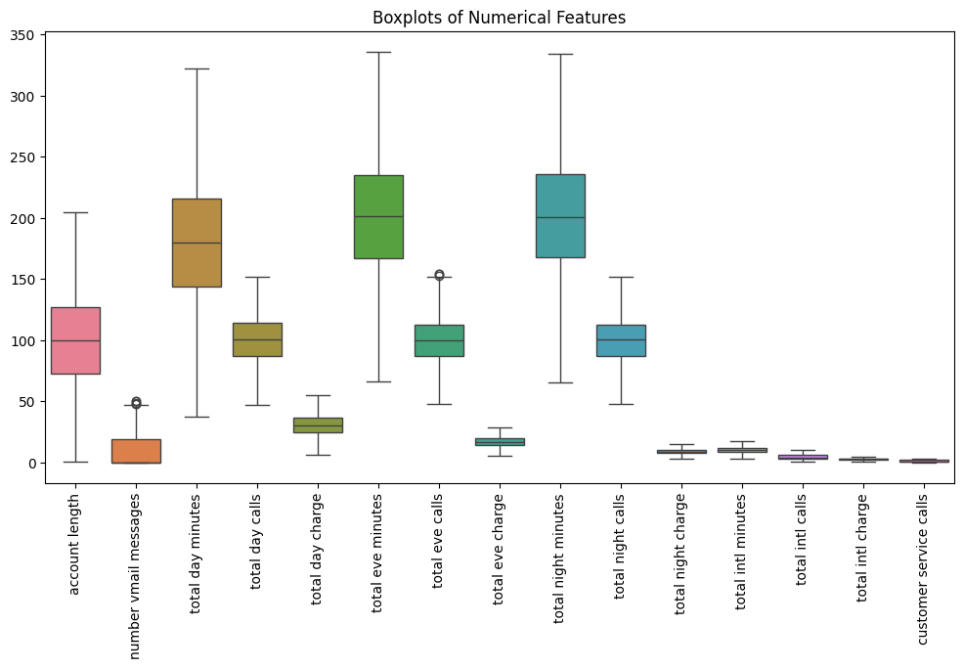
Box plot of detected outliers and removed.
WITH OUTLIERS
WITHOUT OUTLIERS

Slide 7
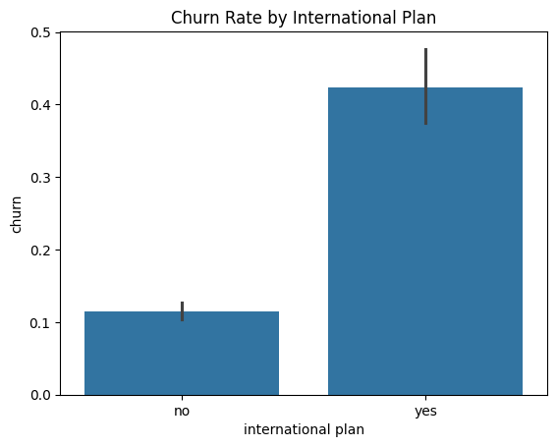
Exploratory Data Analysis (EDA)
Key Insights:
Customers with an international plan are more likely to churn (42% churn rate vs. 11% without the plan).

Slide 8
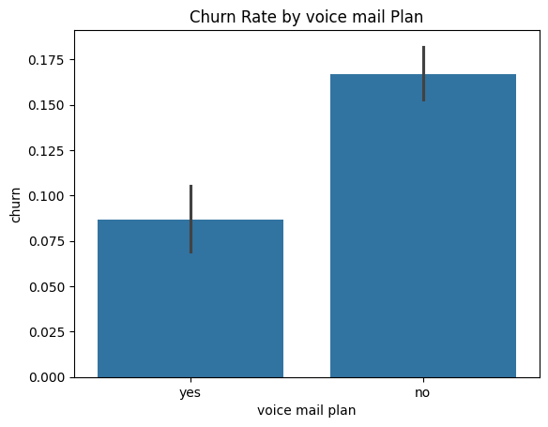
Customers with a voice mail plan churn less (8.6% vs. 16.7% without the plan).

Slide 9
Train-Test Split
Details:
Split dataset into training and test sets (70/30 split).
Observed class imbalance:
Majority: No churn (0) - 2493 instances.
Minority: Churn (1) - 304 instances.

Slide 10
Modeling Approach
Models Evaluated:
Logistic Regression: Baseline model for simplicity and interpretability.
Random Forest Classifier: Combines multiple decision trees for robustness.
Decision Tree Classifier: Simple and interpretable but prone to overfitting.
Evaluation Metrics:
Precision, Recall, F1-Score, AUC-ROC.

Slide 11
Logistic Regression Performance
Results:
Training Accuracy: 89.32%.
Test Accuracy: 88.57%.
AUC: 0.861.
Challenges:
High performance for "No Churn" (97% recall).
Low performance for "Churn" (22% recall).

Slide 12
Random Forest Performance
Results:
Training Accuracy: 100% (Potential overfitting).
Test Accuracy: 94%.
AUC: 0.871.
Highlights:
Best performance among models.
Balanced Precision (68%) and Recall (74%) for "Churn".

Slide 13
Decision Tree Performance
Results:
Training Accuracy: 100% (Severe overfitting).
Test Accuracy: 90.86%.
AUC: 0.814.
Observations:
High precision for "No Churn" (96%).
Moderate recall for "Churn" (72%).

Slide 14
ROC Curve Comparison
Key Points:
Random Forest outperforms Logistic Regression and Decision Tree.
ROC curves demonstrate trade-offs between models.

Slide 15
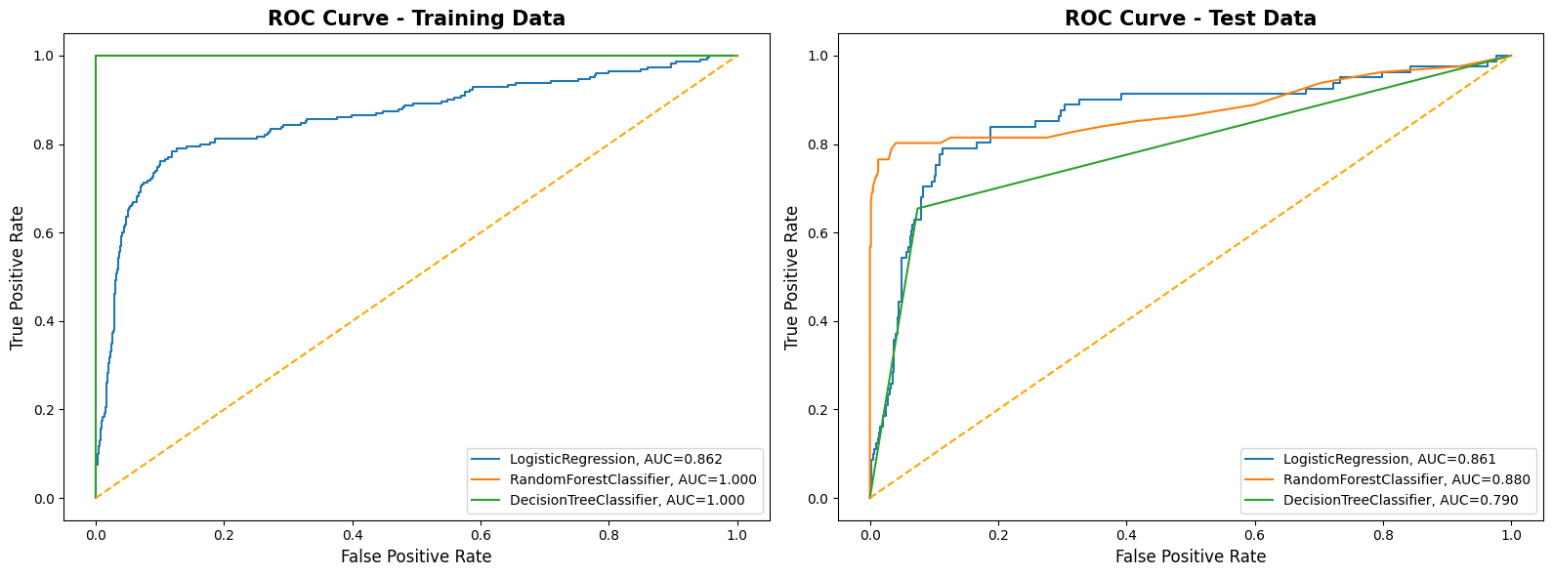
Combined ROC curves for all models.

Slide 16
Feature Importance Analysis
Most Influential Features:
total day minutes (33.4% importance).
international plan (17.3% importance).
total eve minutes (9.4% importance).
Lesser Influential Features:
customer service calls (0.9% importance).
total day calls (3.2% importance).

Slide 17
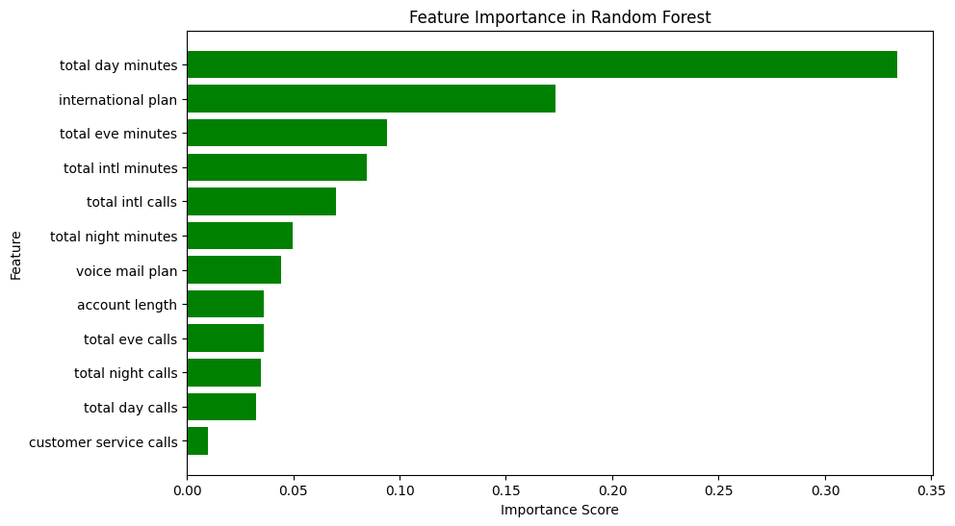
Feature importance bar chart for RF.

Slide 18
Model Selection
Summary:
Random Forest is the best-performing model:
Test Accuracy: 94%.
AUC: 0.871.
Handles class imbalance better with SMOTE resampling.

Slide 19
Conclusion
Key Takeaways:
Random Forest is the most suitable model for deployment.
Focus on features like total day minutes and international plan.
Address class imbalance with SMOTE or similar techniques.
Next Steps:
Optimize hyperparameters further.
Deploy the model in a real-world environment.

Slide 20
Actionable Insights
Focus on High-Risk Customers:
Customers with an international plan have a 42% churn rate.
Target this group with improved international plan offerings or discounts.
Enhance Customer Engagement:
Customers with a voice mail plan churn less (8.6% vs. 16.7% without).
Promote voice mail plans to reduce churn rates.
Monitor Usage Patterns:
High total day minutes is a strong predictor of churn.
Analyze high usage patterns and offer loyalty incentives or tailored plans.

